Slide 1
Web technologies
CSS Part

Slide 2

topics
What is CSS
CSS Syntax
CSS Selectors
Insert CSS in HTML
Specificity
CSS Box Model
CSS Position Property
Important properties
Inline, Block
Units
Webpage Layout

Slide 3
CSS
CSS stands for Cascading Style Sheet
While HTML is used for giving structure to a web page, CSS is used for giving styles to the web page
HTML defines –
Which elements should exist in the page
Which element should come after which
Which element should be inside of which
How to link one web page with another
Basic text formatting (bold, italic, underline etc.)
CSS defines –
Colors, shadows and gradients
Text formatting (font size, font family, font weight, letter spacing, line height etc.)
Height, width, size, shape
Position, alignment
Show or hide
Border, margin, padding, spacing
Layer
Animations, effects, transition, movement
Different design for different screen size (mobile, desktop, tab)
And much more...

Slide 4
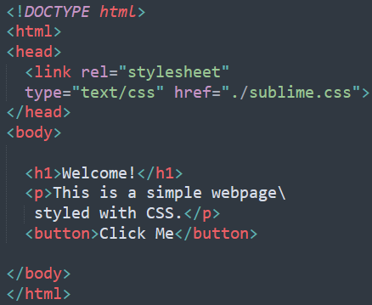
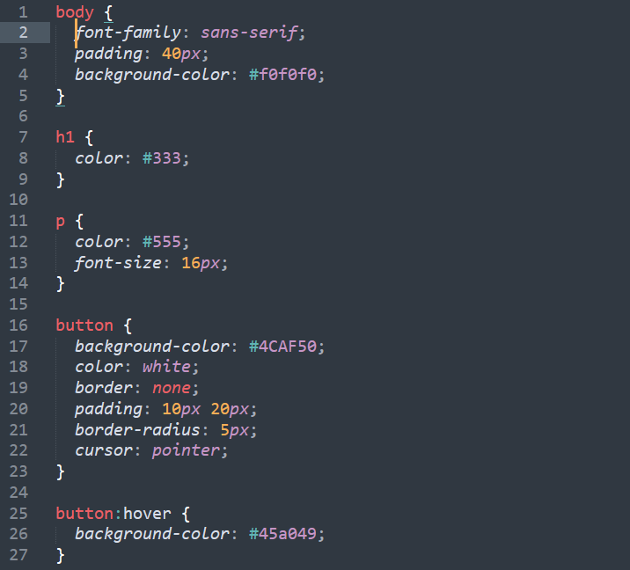
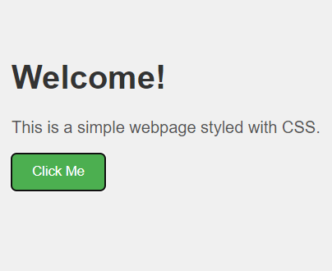
CSS demo

Slide 5
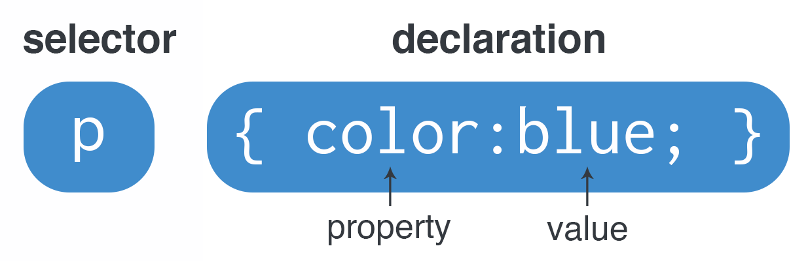
Css syntax
Selector is used to tell which HTML element you want to design
Property is the style that you want to give to that element
Value is the specific value of that property
Note { } and ; and no space should be between value and unit in the syntax

Slide 6
Property
Property Name | Description | Example
color | Used for text color | color: blue;
font-size | Used for font size | font-size: 20px;
font-weight | Thickness of text | font-weight: bold;
font-family | Font family | font-family: Arial, sans-serif;
font-style | Text appearance (normal, italic, oblique) | font-style: italic;
text-align | Align text (center, left, right) | text-align: center;
text-decoration | Adds underline, line-through, etc. | text-decoration: underline;

Slide 7
property
Property Name | Description | Example
height | Height of an element | height: 100px;
width | Width of an element | width: 200px;
min-height, min-width | Minimum height and width of an element | min-width: 200px; min-height: 100px;
max-height, max-width | Maximum height and width of an element | max-width: 600px; max-height: 300px;

Slide 8
property
Property Name | Description | Example
margin (right, left, top, bottom) | Space between multiple elements | margin: 20px;
padding (right, left, top, bottom) | Space between content and border | padding: 20px;
border | Border around an element | border: 2px solid black; border-right: 2px solid black; border-left: 2px solid black; border-top: 2px solid black; border-bottom: 2px solid black;
border-radius | For creating rounded border | border-radius: 10px;

Slide 9
property
Property Name | Description | Example
z-index | Stacking/layering of elements | z-index: 10;
visibility | Hide or Show | visibility: hidden;
box-sizing | Decides if padding, border will be included to total height, width or not | box-sizing: border-box;
position | How elements positioned on the web page (more will be discussed) | position: absolute;
background-color | Background color of an element | background-color: tomato;

Slide 10
selectors
Selectors are used to select HTML elements to style them.
There are 5 categories of CSS selectors –
Simple selectors: element name, id, class
Combinator selector: Based on relationship of multiple elements
Pseudo-class selector: Based on state of an element
Pseudo-element selector: Used for styling a part of an element
Attribute selector: Selected using attribute or attribute value
Favicon
Title

Slide 11
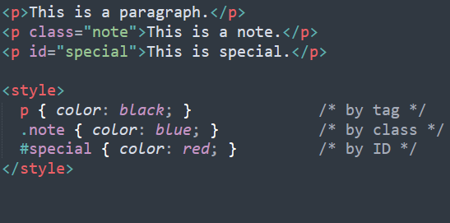
Simple selectors
Element selector: Select HTML elements based on element name.
ID selector: Select a specific HTML element based on its ID.
Class selector: Select multiple HTML elements with same class name.
Favicon
Title

Slide 12
ID vs class
ID selector:
An ID is an HTML attribute used to uniquely identify a single element.
In CSS, the # symbol is used to select elements
Example: #header {color: red;}
Only one element should have a given ID in a page.
ID name should not start with a number
Class selector:
A class is an HTML attribute used to group elements for styling.
In CSS, the . (dot) is used to select elements by class name.
Example: .card { padding: 20px;}
Multiple elements can share the same class.
You can combine a class selector with an element selector.
Example: p.card { color: red; }
Favicon
Title

Slide 13
Selectors
Combinator Selector:
div p { color: blue; }
This selects <p> inside <div>
Pseudo-class Selector:
button:hover { background-color: lightblue; }
This is only applied when mouse hover on a button
Pseudo-element Selector:
p::first-letter { font-size: 24px; }
Only first letter of paragraph
Attribute Selector:
input[type="text"] { border: 1px solid gray; }
Selects based on an attribute or its value
Favicon
Title

Slide 14
Other selectors
Universal Selector:
The universal selector (*) selects all elements of a web page
* { padding: 0px; margin: 0px; }
Grouping Selector:
A grouping selector lets you apply the same CSS rules to multiple elements at once
It separates each selector with commas.
It is used to minimize code
h1, h2, p { text-align: center; color: red; }
Favicon
Title

Slide 15
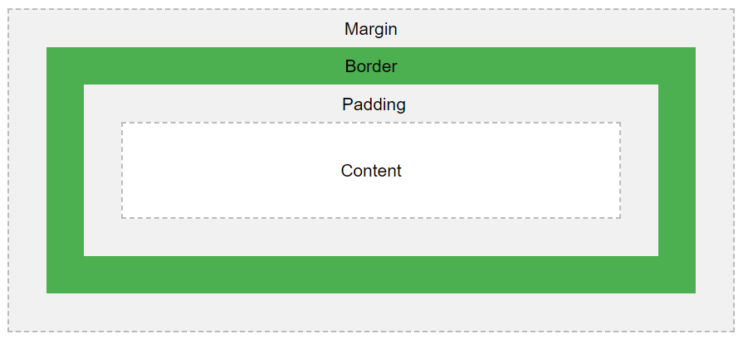
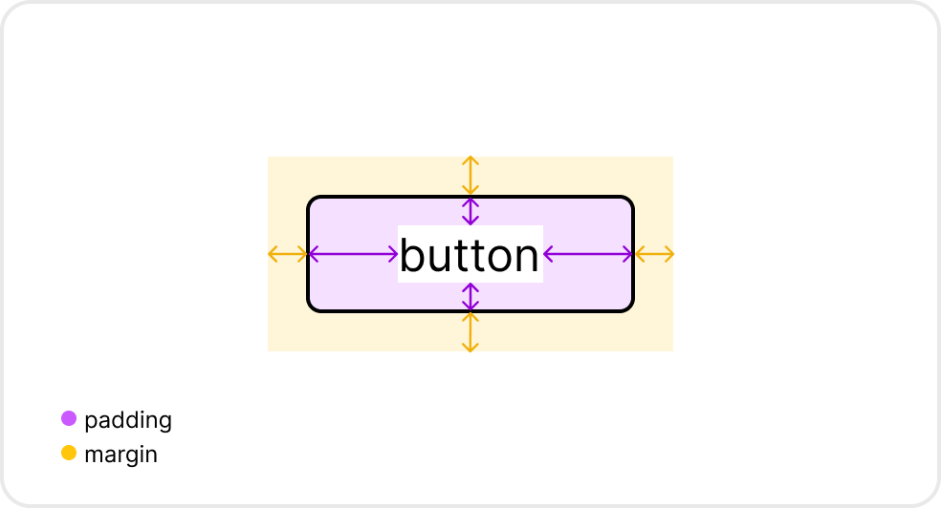
Box model
The CSS box model is a box that wraps around every HTML element.
It consists of: margins, borders, padding, and the actual content.
Favicon
Title
Padding: Spacing between border and content.
Margin: Spacing between the element and other elements.

Slide 16
How to calculate box sizing
The CSS box model is a box that wraps around every HTML element.
It consists of: margins, borders, padding, and the actual content.
div {
width: 320px;
padding: 10px;
border: 5px solid gray;
margin: 10px;
}
320px (width) + 20px (left + right padding) + 10px (left + right border) = 350px
Favicon
Title
Total element width = width + left padding + right padding + left border + right border
Total element height = height + top padding + bottom padding + top border + bottom border
Note: The margin property also affects the total space that the box will take up on the page, but the margin is not included in the actual size of the box.

Slide 17
Position property
CSS Position property is used to specify how an element will be positioned in a web page
Five types of position is possible –
Static: Default positioning (elements flow normally)
Fixed: Fixed at a specific position of the screen
Sticky: Switches between relative and fixed, depending on scroll position
Relative: Positioned relative to its normal position
Absolute: Positioned relative to the nearest positioned ancestor
After defining which position method will be used, we define the position of the the element using css property like top, bottom, left, right
Favicon
Title

Slide 18
Position property
Static:
HTML elements are positioned static by default.
Static positioned elements are not affected by the top, bottom, left, and right properties.
Fixed:
Fixed at a position of the screen
Always stays at the same place even if the page is scrolled.
The top, right, bottom, and left properties are used to position the element.
A fixed element does not leave a gap in the page.
Sticky:
Positioned based on the user's scroll position.
A sticky element toggles between relative and fixed, depending on the scroll position.
Favicon
Title

Slide 19
Position property
Relative:
Positioned relative to its normal position.
CSS property: top, right, bottom, and left will cause it to be move away from its normal position.
Other content does not fill the gap left by the element.
Absolute:
absolute is positioned relative to the nearest positioned ancestor.
an absolute positioned element has no positioned ancestors, it uses the document body, and moves along with page scrolling.
"positioned" element is one whose position is anything except static.
Favicon
Title

Slide 20
Insert css into html
Three ways of inserting CSS into HTML –
External CSS
Internal CSS
Inline CSS
External CSS:
CSS is written in a separate file.
It is connected to the HTML file using the <link> element, inside the <head> section of an HTML page.
Can be reused for multiple HTML files.
<link rel="stylesheet" type="text/css" href=“filename.css">
Favicon
Title

Slide 21
Insert css into html
Internal CSS:
Internal CSS may be used to uniquely style a single HTML page.
The internal style is defined inside the <style> element, inside the head section.
<!DOCTYPE html> <html> <head> <style> body { background-color: linen; } h1 { color: maroon; margin-left: 40px; } </style> </head> <body> <h1>This is a heading</h1> <p>This is a paragraph.</p> </body> </html>
Title

Slide 22
Insert css into html
Inline CSS:
CSS is written directly inside an HTML element’s style attribute
It is used to apply a unique style to a single element only.
<p style="color: blue; font-size: 18px;">This is a styled paragraph.</p>
Title

Slide 23
Specificity
If styles from multiple sources target a single element, only one of the sources ‘win’.
Specificity ranking: External CSS < Internal CSS < Inline CSS < !important
The !important rule is used in CSS to force a style to be applied, overriding all other styles.
Example: p { color: red !important; }
Title

Slide 24
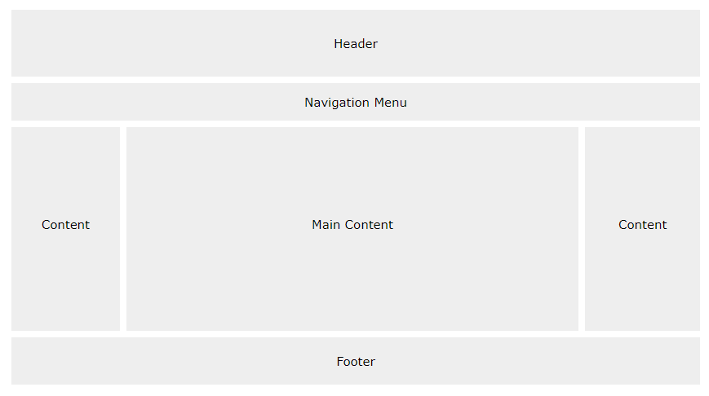
Website layout
Title

